Slide 1
Pandas
Getting started

Slide 2
What is pandas?
Name is derived from “panel data”
Open source, originally written by Wes Mackinney
Software of choice across several domains (neuroscience, finance, economics, statistics, web analytics, …)
Provides additional functionality of high-level spreadsheets and databases
Built on top of NumPy

Slide 3
DataFrame object as Main goal
DATA (table format)
pandas
DataFrame object
.csv . xls .sql .json
Easier to work with than lists, dictionaires

Slide 4
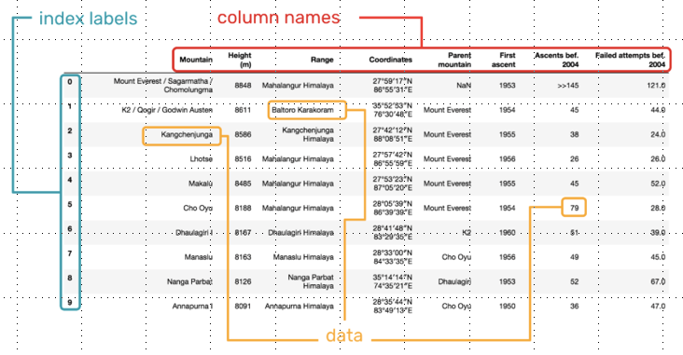
Components of a DataFrame

Slide 5
In addition to DataFrame object
Tools for reading and writing data
Data alignment and integrated handling of missing data
Ability to perform arithmetic operations
Easy reshaping and pivoting of datasets
User-friendly operations for merging and joining data
Ability to handle time series

Slide 6
Pandas main strenghts
User-friendly
Efficient – highly optimized for performance

